Slide 1


Population Health Data Sciences Machine Learning Workshop
Vijaya Kolachalama & Evan Johnson

Slide 2
Agenda
Introduction to Machine Learning Terminology
Definition of features, labels, data preparation, input, output, etc.
Overview of Machine Learning Methods
Data preparation
Supervised and unsupervised learning
Model training and testing
Model evaluation / performance metrics
Kernel-based Methods
Conceptual understanding
Decision Trees
Neural Networks
Code + case studies are integrated throughout

Slide 3
Formal definitions
Machine learning is a computer’s way of learning from examples, and it is one of the most useful tools we have for the construction of artificially intelligent systems
Artificial intelligence is a term used when machines (or computers) can mimic functions that humans can do.
Example: Learning and problem solving

Slide 4
Formal definitions
Algorithm:
Sequence of actions that are “self-contained”
Effective method for calculation
Finite steps/instructions
When applied, it produces a correct answer
The instructions need to be followed
In principle, it can be done by a “human”

Slide 5
Formal definitions
Computer Algorithm:
Sequence of actions that are “self-contained”
Effective method for calculation
Finite steps/instructions
When applied, it produces a correct answer
The instructions need to be followed
In principle, it can be done by a “computer”

Slide 6
Formal definitions
Computer Code:
Human readable text
Fully executable description of a software system
What’s in the data?
Datum: “(thing) given”
Data is useful only when it has been analyzed

Slide 7
Supervised vs unsupervised learning
Machine learning algorithms are generally classified into two categories:
Supervised: Outcomes used to create the predictor, e.g., classification.
Unsupervised: Don't know outcomes, rather interested in discovering groups, e.g., clustering.

Slide 8
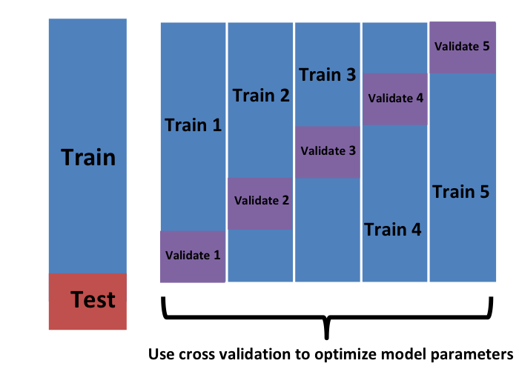
Formal definitions
Training and Test sets: We usually split our dataset into two parts, one for model creation (train) and one for validation (test)
Cross-validation: Iterative retraining of the predictor on multiple partitions of training set

Slide 9
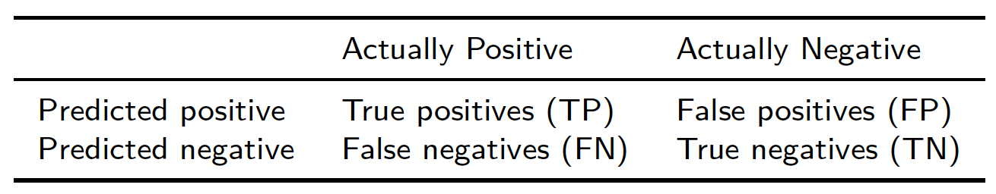
Formal definitions
Confusion matrix: tabulates each combination of predicted and actual values:
Overfitting: Dangerously over-optimistic assessments— this is a big problem in machine learning

Slide 10
The caret package in R
The caret package in R has several useful functions for building and assessing machine learning methods.
Examples:

Slide 11
Regularization
Regularization is used to penalize complex models, deployed for reducing overfitting. Examples include:
Regression: Penalizing coefficients to create parsimonious models (variable selection)
K-means: Restricting the segments for avoiding redundant groups.
Random forests: Reducing the depths of tree and branches (new features)
Neural networks: Confining the complexity (weights) of a model.

Slide 12
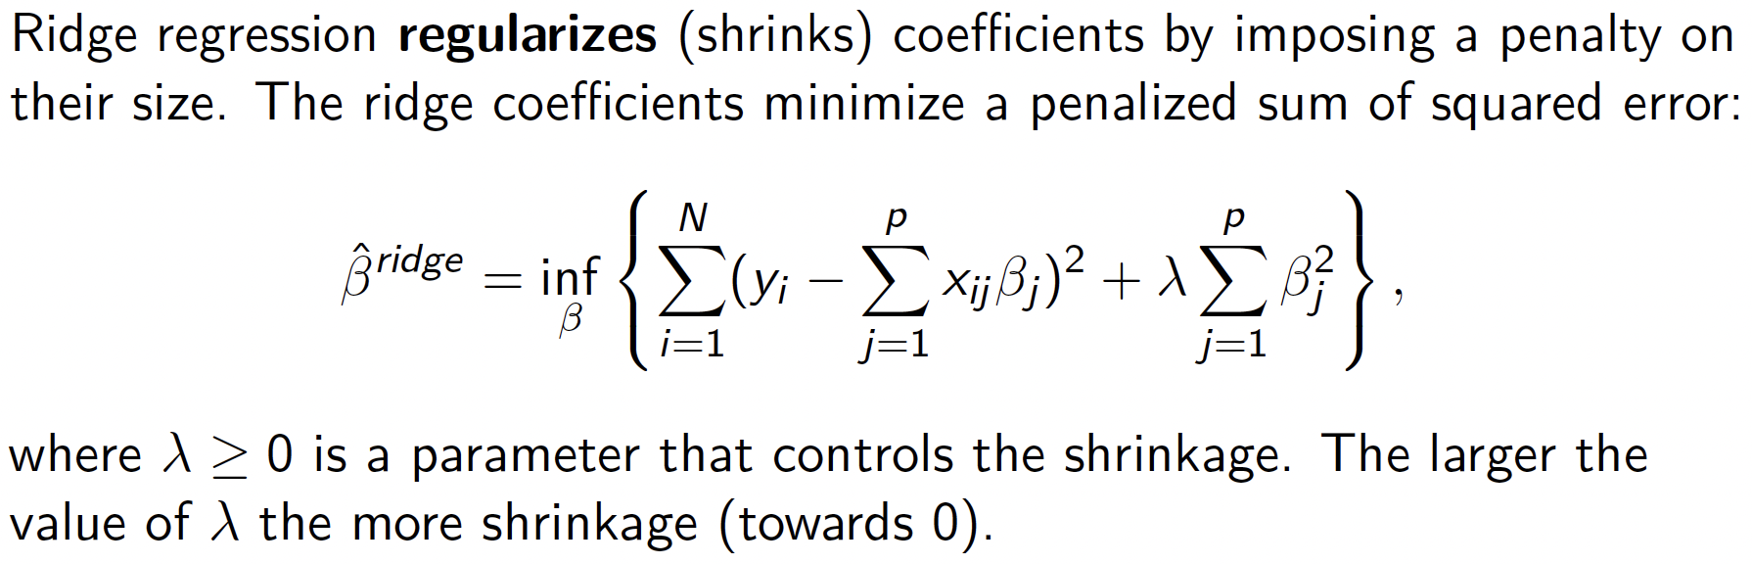
Regularization Example: Ridge Regression

Slide 13
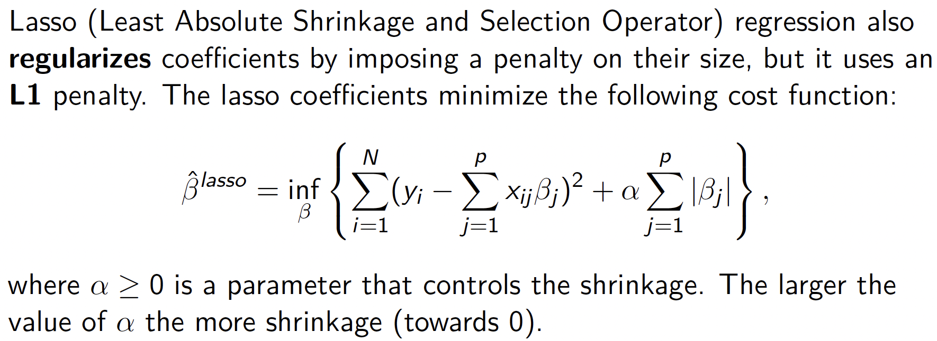
Regularization Example: LASSO Regression

Slide 14
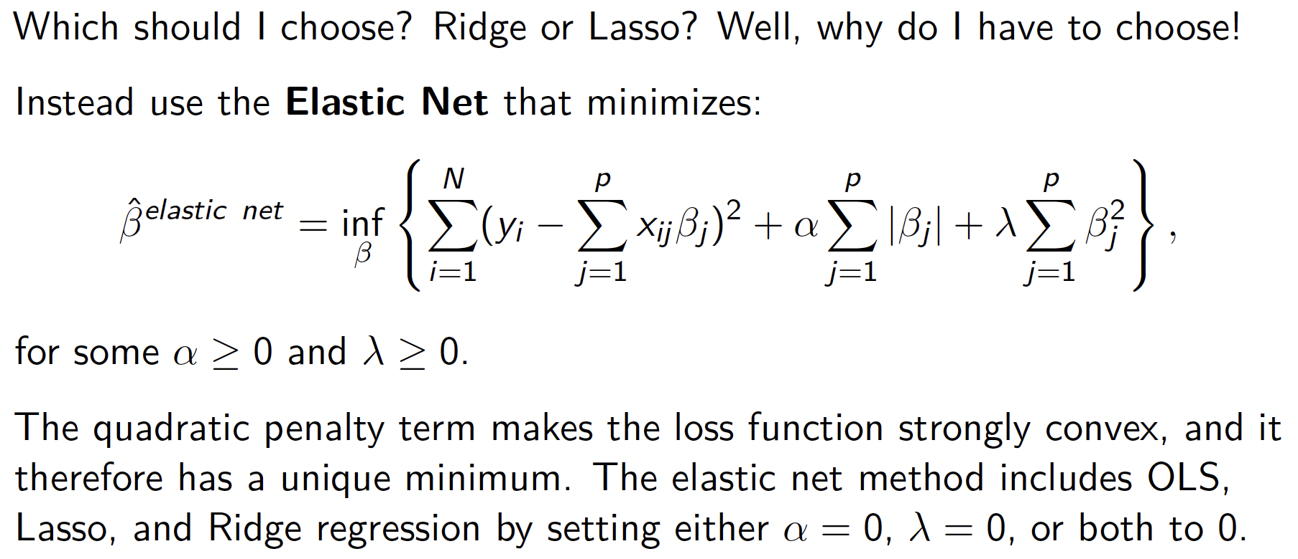
Regularization Example: Elastic Net
We can use the glmnet package to apply Elastic Net regularization in R

Slide 15
Kernel-based machine learning
Kernel machines are a class of methods for pattern analysis that use linear classifiers to solve nonlinear problems.
Kernel methods only require a user-specified kernel, i.e., a similarity function over all pairs of data points computed using inner products.
In contrast, many other algorithms require the explicit transformation of the raw data.

Slide 16
Kernel based machine learning
Algorithms that operate with kernels include:
Kernel perceptron
Support-vector machines (SVM)
Gaussian processes
Principal components analysis (PCA)
Canonical correlation analysis
Ridge regression
Spectral clustering
Linear adaptive filters

Slide 17
Support Vector Machines
Support vector machines (SVMs) are supervised learning models analyze data for classification and regression analysis.
The goal is to find a classifier by identifying an optimized decision boundary or “separating hyperplane” between two classes
Note: These materials were obtained and adapted from:
https://www.datacamp.com/community/tutorials/support-vector-machines-r
The Elements of Statistical Learning, Hastie, et al., Springer
https://www.geeksforgeeks.org/classifying-data-using-support-vectormachinessvms-in-r/amp/

Slide 18
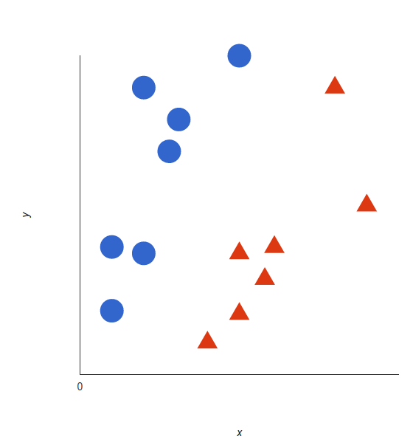
Support Vector Machines (Linear Data)
Let’s imagine we have two tags: red and blue, and our data has two features: x and y. We can plot our training data on a plane:

Slide 19
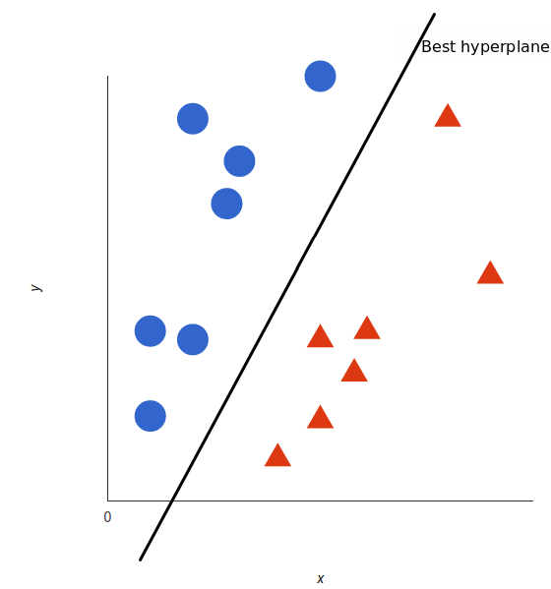
Support Vector Machines (Linear Data)
An SVM identifies the decision boundary or hyperplane (two dimensions: line) that best separates the tags:

Slide 20
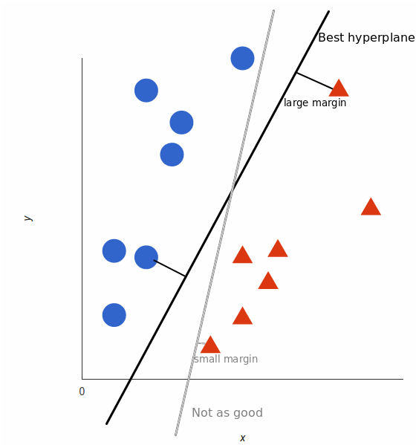
Support Vector Machines (Linear Data)
But what exactly is the best hyperplane? For SVM, it’s the one that maximizes the margins from the data from both tags:

Slide 21
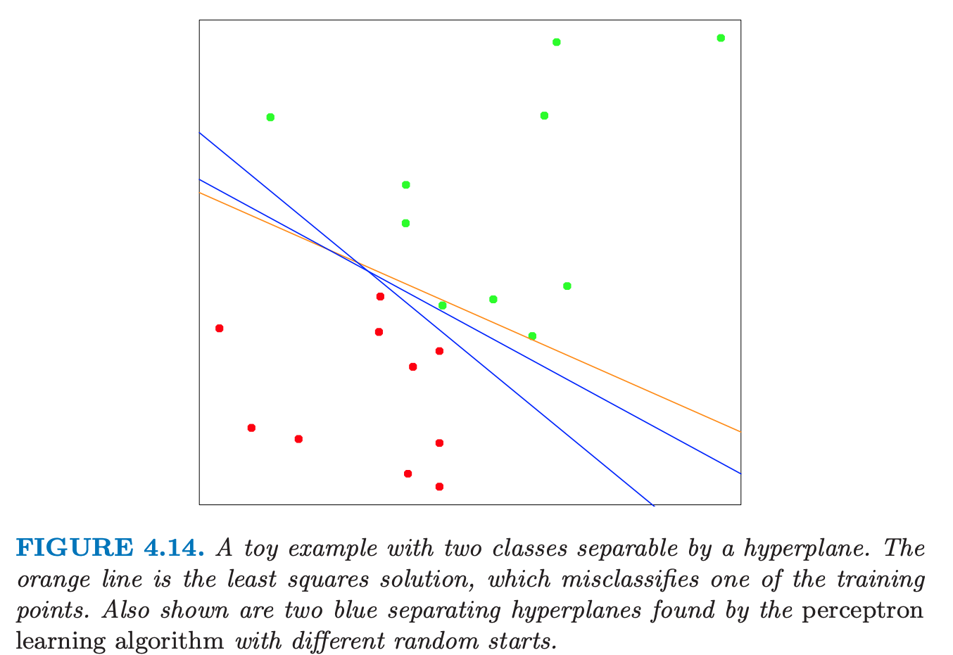
A Look into SVM Methodology

Slide 22
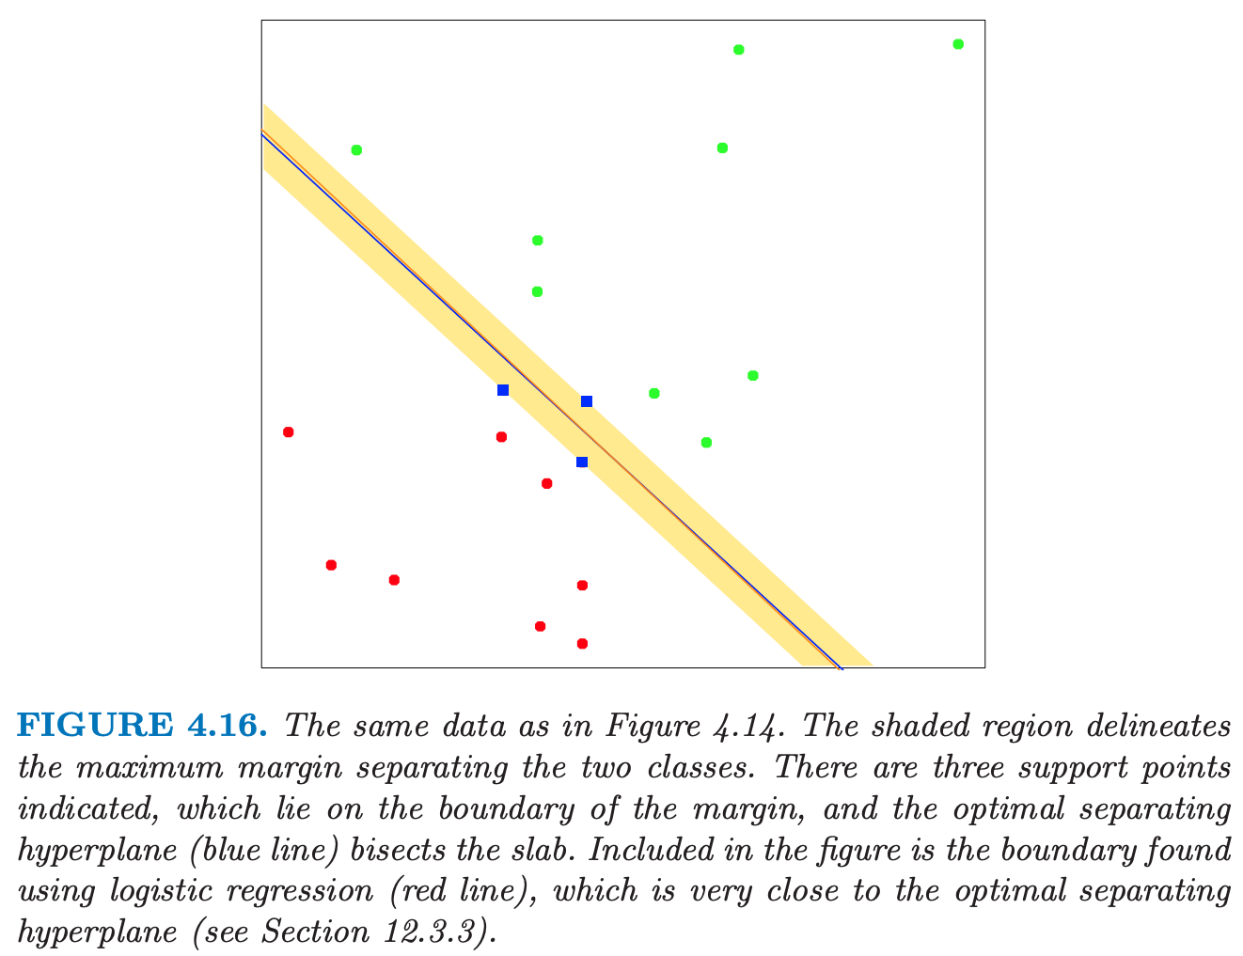
A Look into SVM Methodology

Slide 23
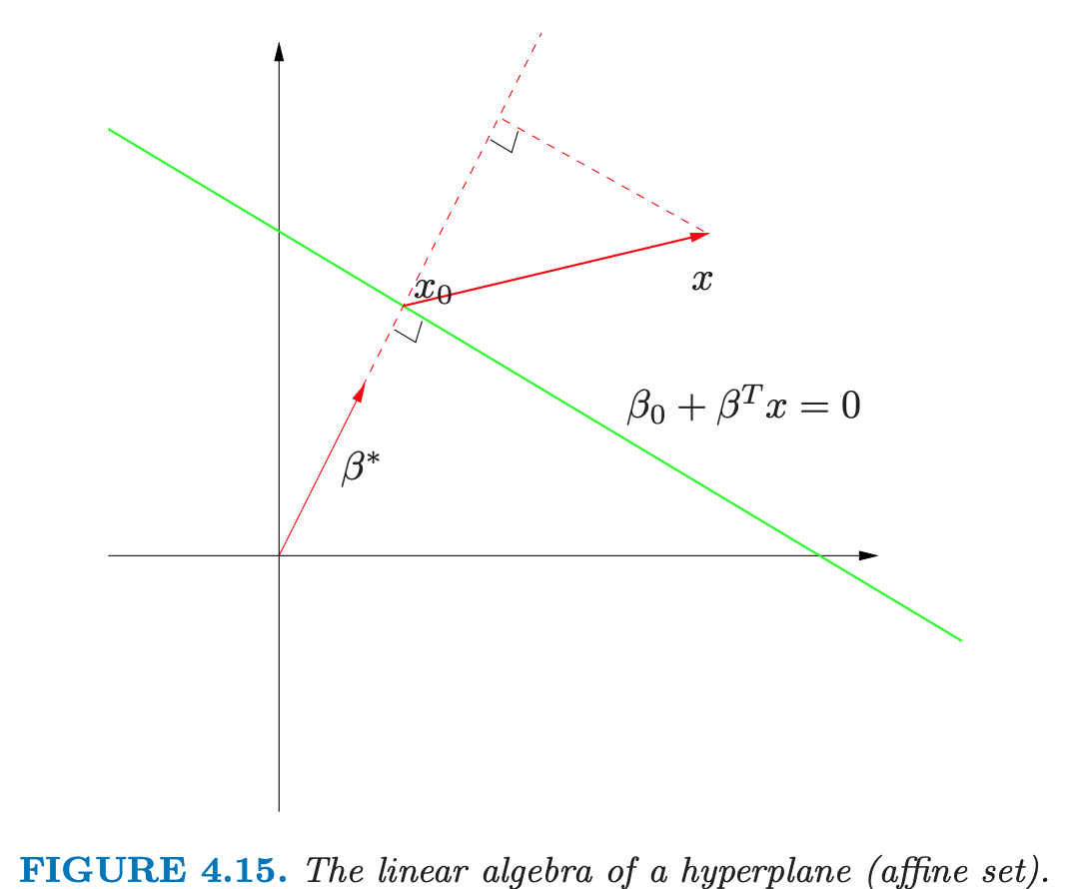
A Look into SVM Methodology

Slide 24
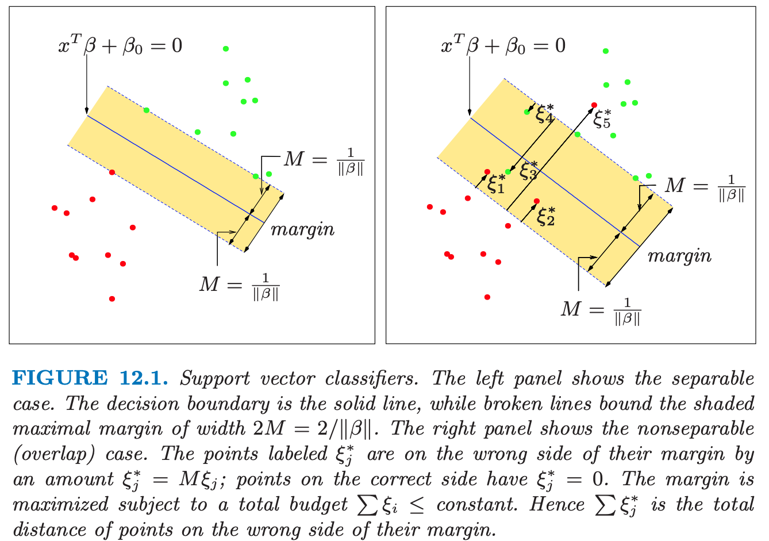
A Look into SVM Methodology

Slide 25
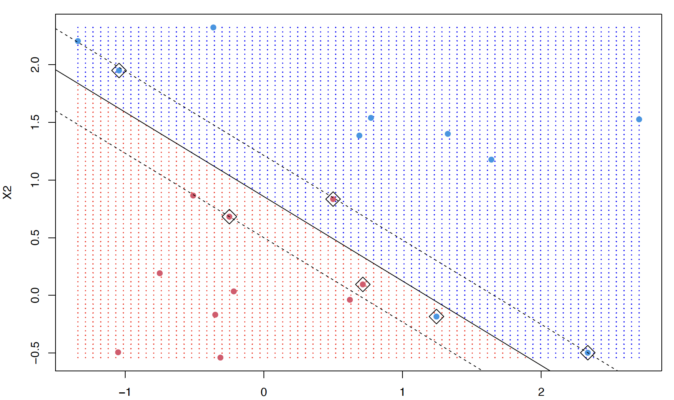
SVM Example in R
Use the e1071 package which contains an SVM function:

Slide 26
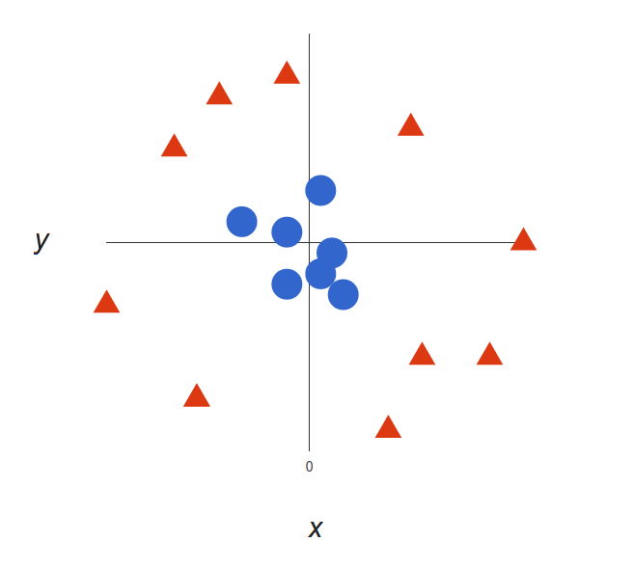
Support Vector Machines (Non-Linear Data)
The prior examples were easy because the data were linearly separable. Often things aren’t that simple. Look at this case:

Slide 27
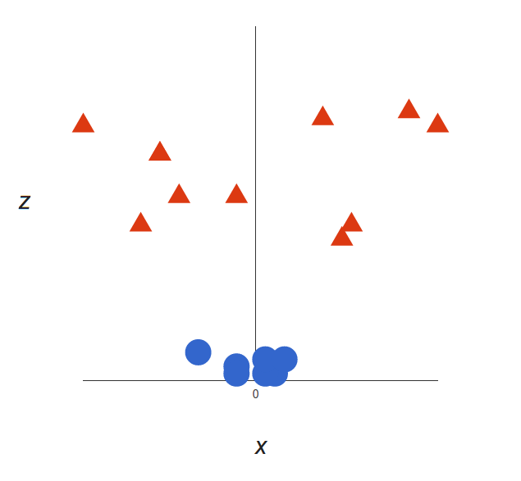
Support Vector Machines (Non-Linear Data)
Here we will add a third dimension: z = x² + y² (you’ll notice that’s the equation for a circle!), and plot x and z.

Slide 28
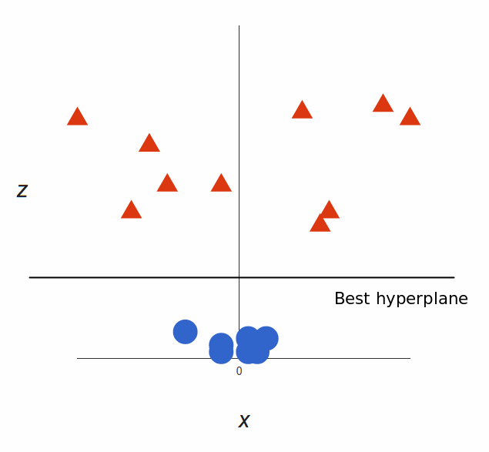
Support Vector Machines (Non-Linear Data)
What can SVM do with this? Easy! The best hyperplane is parallel to the x axis at a certain z (let’s say z=1).

Slide 29
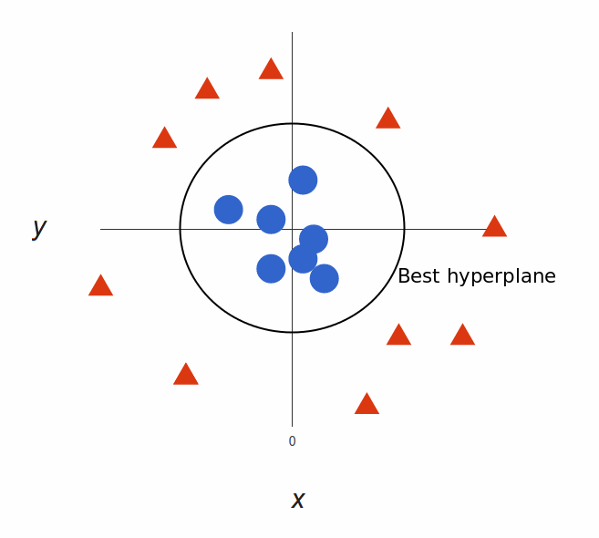
Support Vector Machines (Non-Linear Data)
Mapping it back to x and y: Our decision boundary is a circle with a radius 1, which separates both tags using an SVM.

Slide 30
The “Kernel Trick”
Transformations are computationally expensive, but SVM doesn’t need the actual vectors, it only needs the dot products.
We can tell SVM to do its thing using the new dot product—we call this a kernel function.

Slide 31
The “Kernel Trick”
This often called the “kernel trick”, which enlarges the feature space for a non-linear boundary between the classes.
Common types of kernels: linear, polynomial, and radial basis kernels.
Simply, these kernels transform our data to pass a linear hyperplane and thus classify our data.

Slide 32
Advantages of SVMs
High Dimensionality: SVM is an effective tool in spaces where dimensionality is large.
Memory Efficiency: Only a subset of the training points are used, so just these points need to be stored in memory.
Versatility: Class separation is often highly non-linear. The ability to apply new kernels allows flexibility for the decision boundaries.

Slide 33
Disadvantages of SVMs
Kernel Selection: SVMs are very sensitive to the choice of the kernel parameters.
High dimensionality: When the number of features for each object exceeds the number of training data samples, SVMs can perform poorly.
Non-Probabilistic: The classifier works by placing objects above/below a classifying hyperplane, there is no direct probabilistic interpretation.

Slide 34
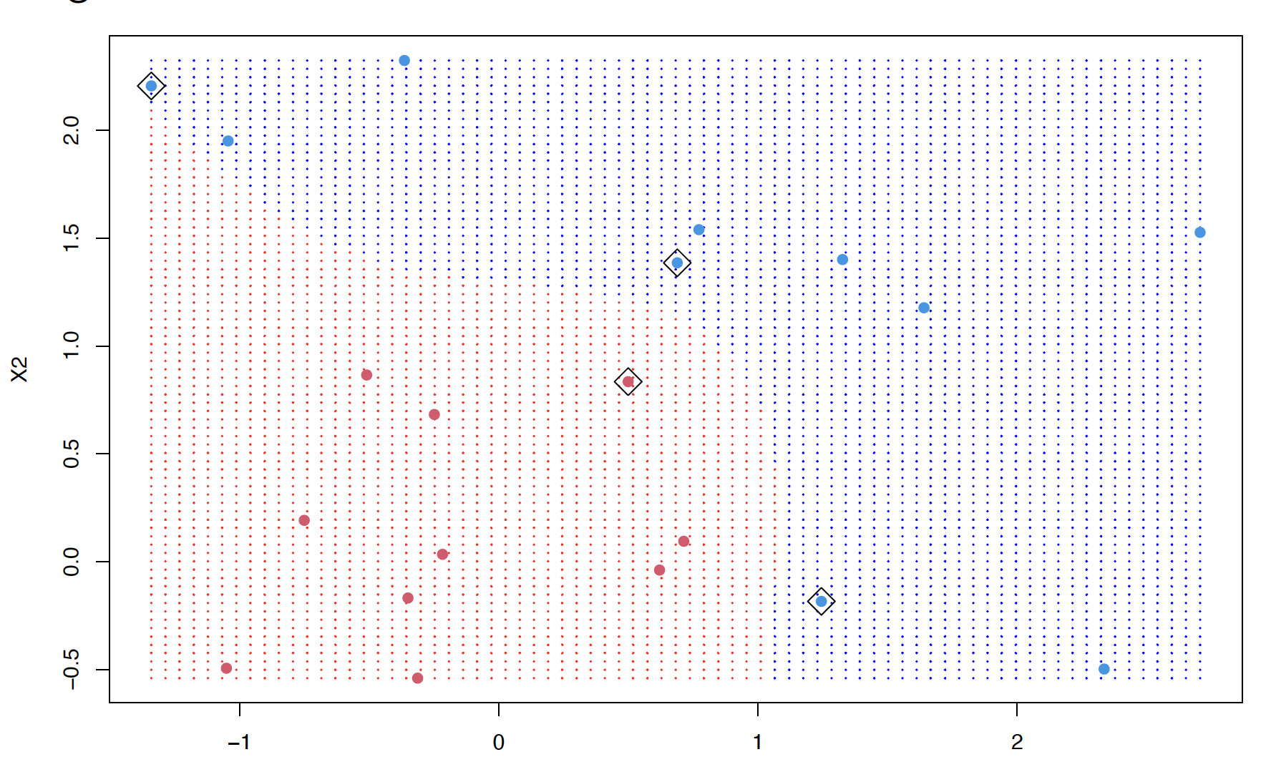
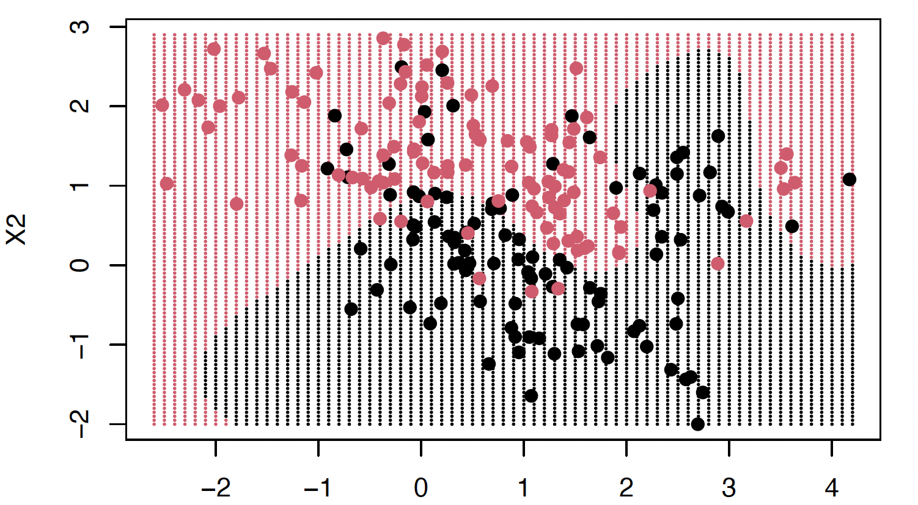
Non-linear SVM Examples in R

Slide 35
Sample population
Subject ID | BMI (kg/m²) | Smoking status | Diabetes | Heart disease
1 | Normal | Yes | Yes | No
2 | Obese | Yes | Yes | Yes
3 | Obese | No | No | No
4 | Normal | No | Yes | Yes
5 | Normal | No | Yes | No
6 | Obese | Yes | No | Yes
7 | Normal | Yes | Yes | No
8 | Normal | Yes | Yes | Yes
9 | Obese | No | No | No

Slide 36
Simple decision tree
Diabetes
Root node
Yes
No
Leaf nodes
Heart disease
Heart disease
Yes | No
3 | 3
Yes | No
1 | 2

Slide 37
Simple decision tree
BMI
Normal
Obese
Heart disease
Heart disease
Yes | No
2 | 3
Yes | No
2 | 2

Slide 38
Simple decision tree
Smoking status
Yes
No
Heart disease
Heart disease
Yes | No
3 | 2
Yes | No
1 | 3

Slide 39
Performance of leaf nodes
All the leaf nodes are “impure” because none of them resulted in perfect prediction of heart disease.
Measure impurity:
1 – p₁² – p₂²
1 – (probability of “yes”)² – (probability of “no”)²
Gini impurity

Slide 40
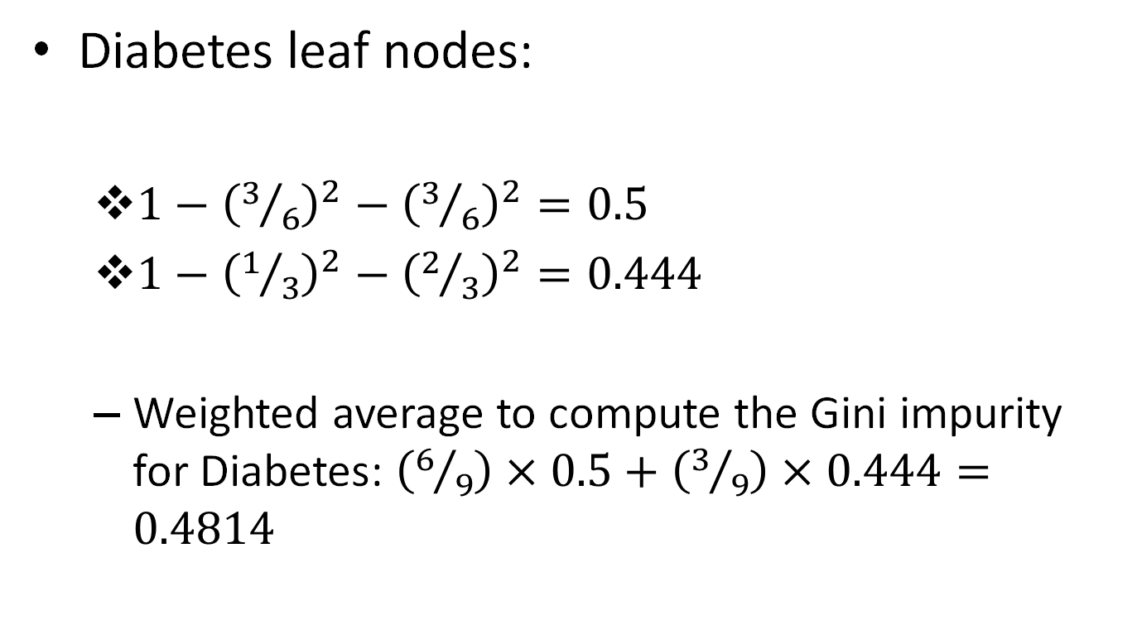
Compute Gini impurity
Diabetes leaf nodes:
$1−{\left(3/6\right)}^{2}−{\left(3/6\right)}^{2}=0.5$
$1−{\left(1/3\right)}^{2}−{\left(2/3\right)}^{2}=0.444$
Weighted average to compute the Gini impurity for Diabetes: $\left(6/9\right)×0.5+\left(3/9\right)×0.444=0.4814$

Slide 41
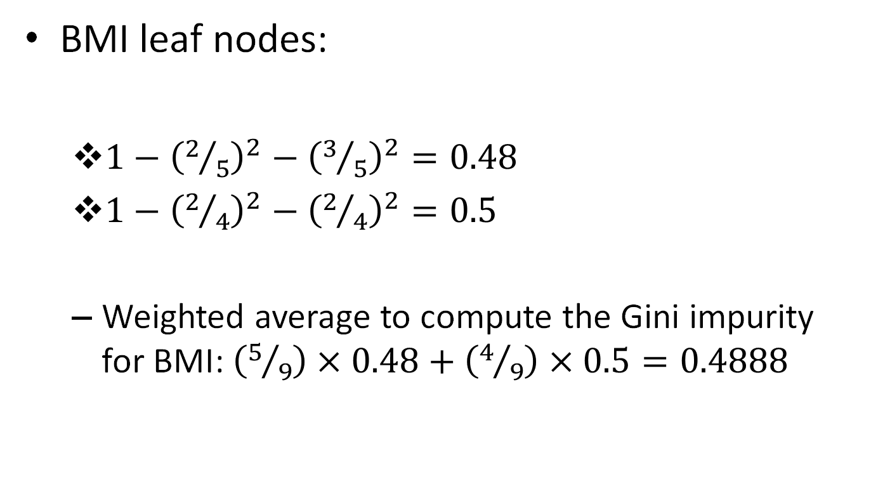
Compute Gini impurity
BMI leaf nodes:
$1−{\left(2/5\right)}^{2}−{\left(3/5\right)}^{2}=0.48$
$1−{\left(2/4\right)}^{2}−{\left(2/4\right)}^{2}=0.5$
Weighted average to compute the Gini impurity for BMI: $\left(5/9\right)×0.48+\left(4/9\right)×0.5=0.4888$

Slide 42
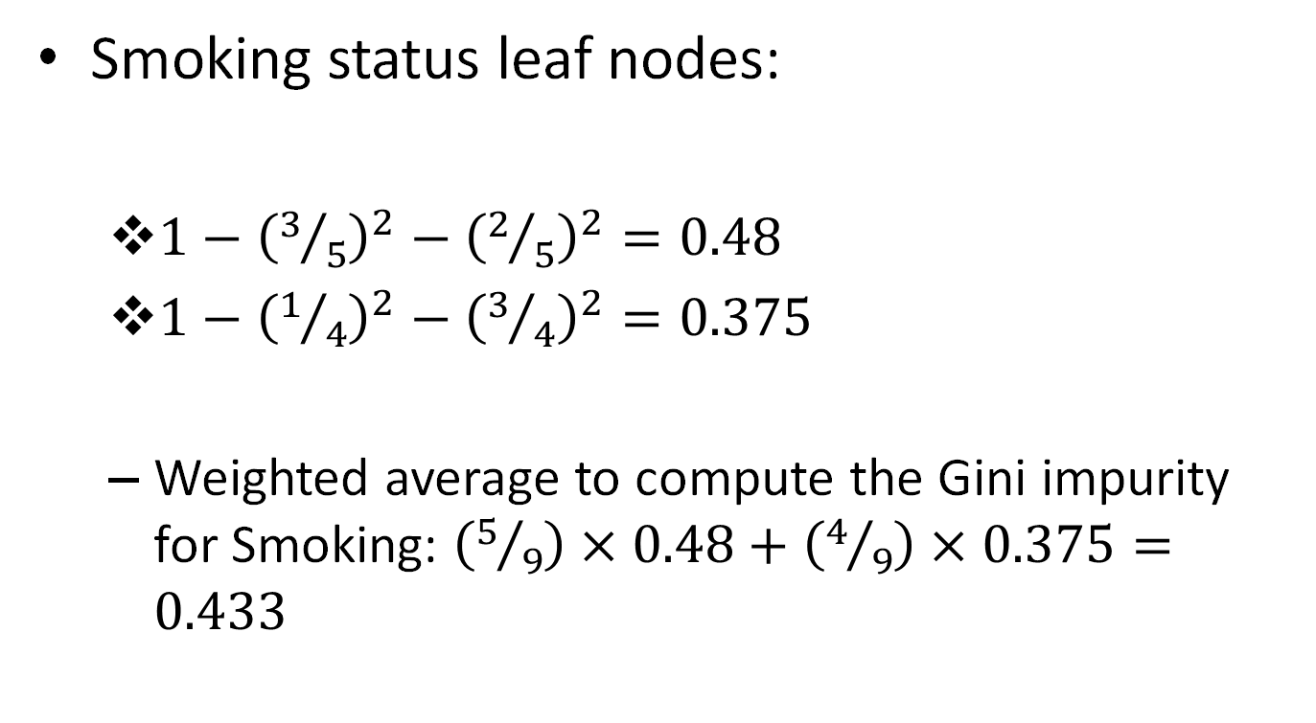
Compute Gini impurity
Smoking status leaf nodes:
$1−{\left(3/5\right)}^{2}−{\left(2/5\right)}^{2}=0.48$
$1−{\left(1/4\right)}^{2}−{\left(3/4\right)}^{2}=0.375$
Weighted average to compute the Gini impurity for Smoking: $\left(5/9\right)×0.48+\left(4/9\right)×0.375=0.433$

Slide 43
Full decision tree
Smoking status
(5/9)
(4/9)
Yes
No
Diabetes
Diabetes
Yes
No
Yes
No
(4/5)
(1/5)
(2/4)
(2/4)
BMI
BMI
BMI
BMI
Obese
Normal
Ob
Nor
Ob
(1/4)
(3/4)
(2/2)
(2/2)

Slide 44
Basic workflow
Calculate the impurity scores for each node
If the node has the lowest score, then stop!
This becomes a leaf node
If splitting the data results in an improvement, then select the split that has the lowest impurity value

Slide 45
Sample population
Subject ID | BMI (kg/m²) | SBP (mmHg) | Smoking status | Diabetes | Heart disease
1 | Normal | 130 | Yes | Yes | No
2 | Obese | 210 | Yes | Yes | Yes
3 | Obese | 110 | No | No | No
4 | Normal | 190 | No | Yes | Yes
5 | Normal | 160 | No | Yes | No
6 | Obese | 200 | Yes | No | Yes
7 | Normal | 100 | Yes | Yes | No
8 | Normal | 140 | Yes | Yes | Yes
9 | Obese | 120 | No | No | No

Slide 46
Sample population
Sort the column
Estimate impurity for each average feature
Subject ID | BMI (kg/m²) | SBP (mmHg) | Smoking status | Diabetes | Heart disease
7 | Normal | 100 | Yes | Yes | No
3 | Obese | 110 | No | No | No
9 | Obese | 120 | No | No | No
1 | Normal | 130 | Yes | Yes | No
8 | Normal | 140 | Yes | Yes | Yes
5 | Normal | 160 | No | Yes | No
4 | Normal | 190 | No | Yes | Yes
6 | Obese | 200 | Yes | No | Yes
2 | Obese | 210 | Yes | Yes | Yes
105
115
125
135
…

Slide 47
Simple decision tree
SBP > 135 mmHg
Yes
No
Heart disease
Heart disease
Yes | No
4 | 1
Yes | No
0 | 4

Slide 48
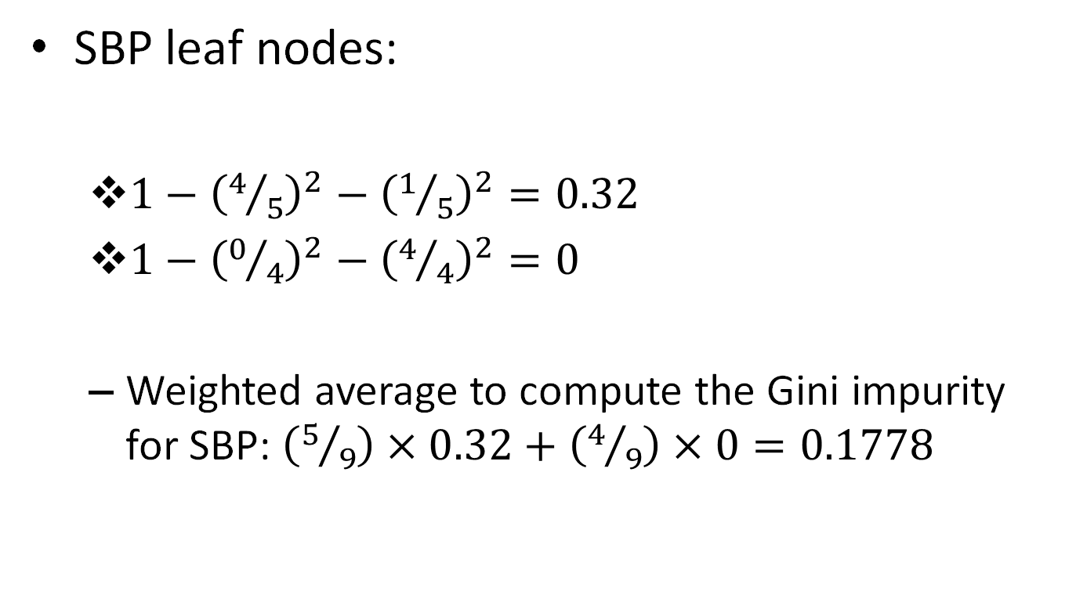
Compute Gini impurity
SBP leaf nodes:
$1−{\left(4/5\right)}^{2}−{\left(1/5\right)}^{2}=0.32$
$1−{\left(0/4\right)}^{2}−{\left(4/4\right)}^{2}=0$
Weighted average to compute the Gini impurity for SBP: $\left(5/9\right)×0.32+\left(4/9\right)×0=0.1778$

Slide 49
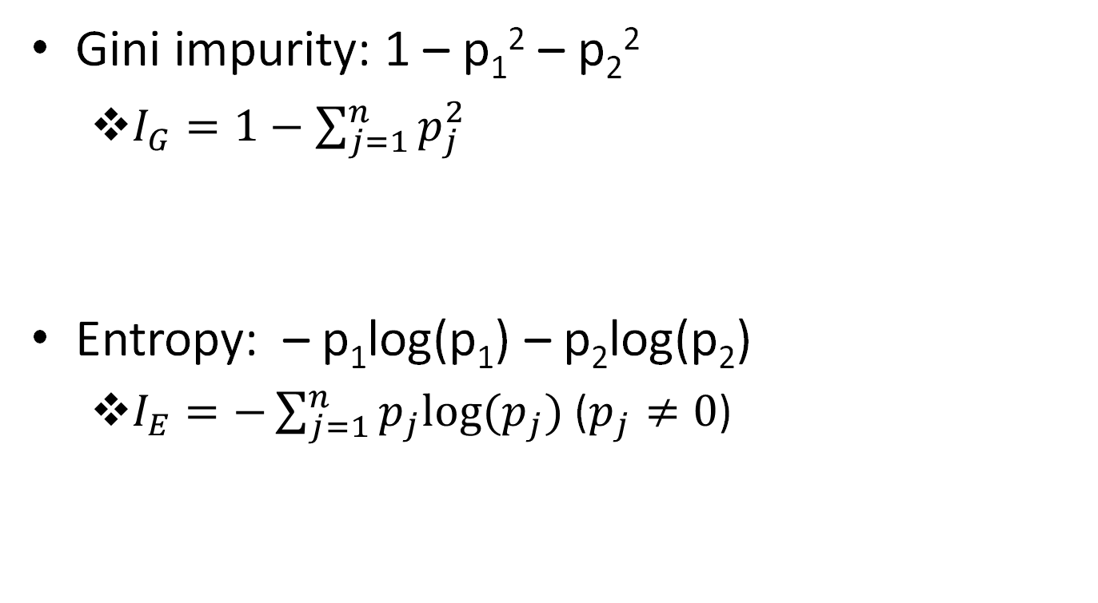
Impurity criterion
Gini impurity: 1 – p₁² – p₂²
$I_{G}=1−\sum_{j=1}^{n}{p_{j}^{2}}$
Entropy: – p₁log(p₁) – p₂log(p₂)
$I_{E}=−\sum_{j=1}^{n}{p_{j}log⁡(p_{j})}$ ($p_{j}≠0$)

Slide 50
Dealing with missing data
Imputation
Simple imputation
Imputations from multiple features
Define new category
Surrogate splits (Decision trees)
Choose another correlated feature as a surrogate to make the split decision
Fragment (Decision trees)
Divide the feature itself by looking at all the data points when a specific feature was not missing and then use that fraction to make the split
Expectation maximization

Slide 51
Ensemble learning
Data
Train
Logistic regression
kNN
SVM
Decision tree
Model 1
Model 2
Model 3
Model 4
Y1 (Test)
Y2 (Test)
Y3 (Test)
Y4 (Test)
Test
Voting: {Yi}

Slide 52
Sample population
Subject ID | BMI (kg/m²) | SBP (mmHg) | Smoking status | Diabetes | Heart disease
1 | Normal | 130 | Yes | Yes | No
2 | Obese | 210 | Yes | Yes | Yes
3 | Obese | 110 | No | No | No
4 | Normal | 190 | No | Yes | Yes
5 | Normal | 160 | No | Yes | No
6 | Obese | 200 | Yes | No | Yes
7 | Normal | 100 | Yes | Yes | No
8 | Normal | 140 | Yes | Yes | Yes
9 | Obese | 120 | No | No | No

Slide 53
Single decision tree
SBP > 135 mmHg
Yes
No
Heart disease
Heart disease
Yes | No
4 | 1
Yes | No
0 | 4

Slide 54
Full decision tree
Smoking status
(5/9)
(4/9)
Yes
No
Diabetes
Diabetes
Yes
No
Yes
No
(4/5)
(1/5)
(2/4)
(2/4)
BMI
BMI
BMI
BMI
Obese
Normal
Ob
Nor
Ob
(1/4)
(3/4)
(2/2)
(2/2)

Slide 55
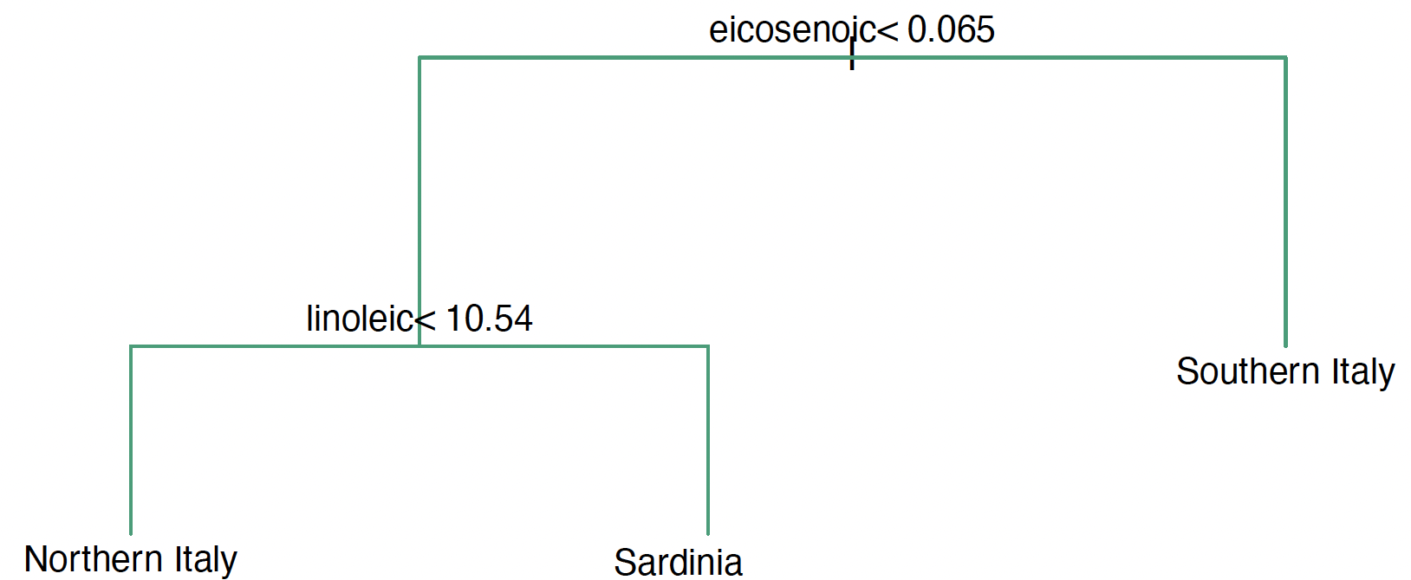
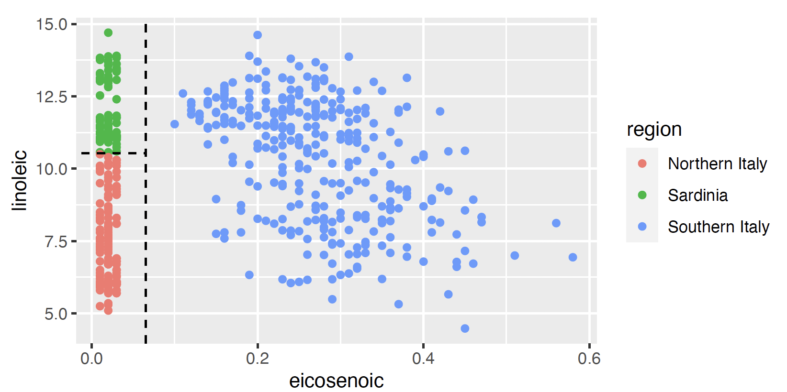
Simple decision trees in R

Slide 56
Generating more training data
Bootstrapping:
Random sampling with replacement
Subject ID | BMI (kg/m²) | SBP (mmHg) | Smoking status | Diabetes | Heart disease
1 | Normal | 130 | Yes | Yes | No
1 | Normal | 130 | Yes | Yes | No
3 | Obese | 110 | No | No | No
4 | Normal | 190 | No | Yes | Yes
5 | Normal | 160 | No | Yes | No
4 | Normal | 190 | No | Yes | Yes
7 | Normal | 100 | Yes | Yes | No
4 | Normal | 190 | No | Yes | Yes
9 | Obese | 120 | No | No | No

Slide 57
Build decision trees
Use the bootstrapped dataset and generate decision trees with a random set of features.
Subject ID | BMI (kg/m²) | SBP (mmHg) | Smoking status | Diabetes | Heart disease
1 | Normal | 130 | Yes | Yes | No
1 | Normal | 130 | Yes | Yes | No
3 | Obese | 110 | No | No | No
4 | Normal | 190 | No | Yes | Yes
5 | Normal | 160 | No | Yes | No
4 | Normal | 190 | No | Yes | Yes
7 | Normal | 100 | Yes | Yes | No
4 | Normal | 190 | No | Yes | Yes
9 | Obese | 120 | No | No | No

Slide 58
Ensemble of decision trees
Generate bootstrapped datasets
Construct decision trees using the bootstrapped data and random features
Predict output using each decision tree
Use the aggregate all the outputs to make the decision
Bagging
Random forests

Slide 59
Ensemble learning
Data
Train
Bagging
Bagging
Bagging
Bagging
Model 1
Model 2
Model 3
Model 4
Test
Boosting: Adaptive ensemble learning to boost performance
AdaBoost

Slide 60
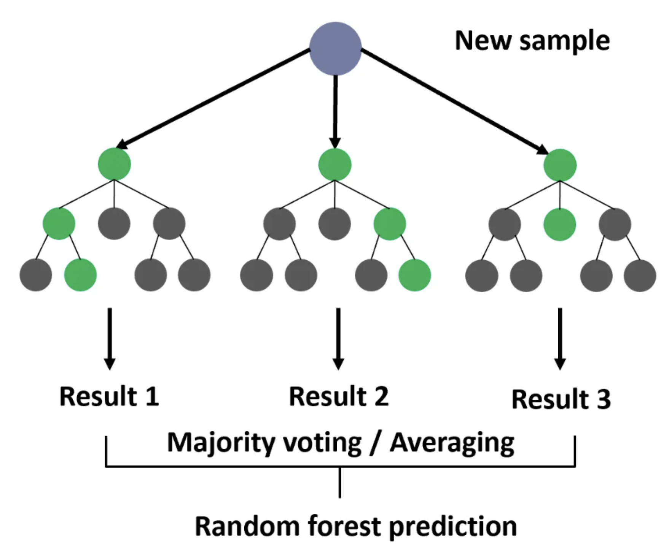
Random Forests in R

Slide 61
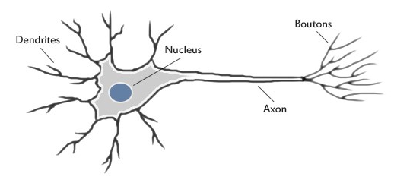
Some definitions
A neuron collects information from other neurons using dendrites
A neuron can sum all the inputs
If the value of the sum is greater than a threshold, it fires

Slide 62
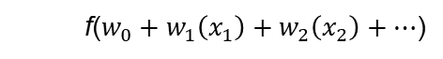
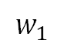
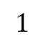
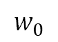
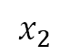
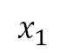
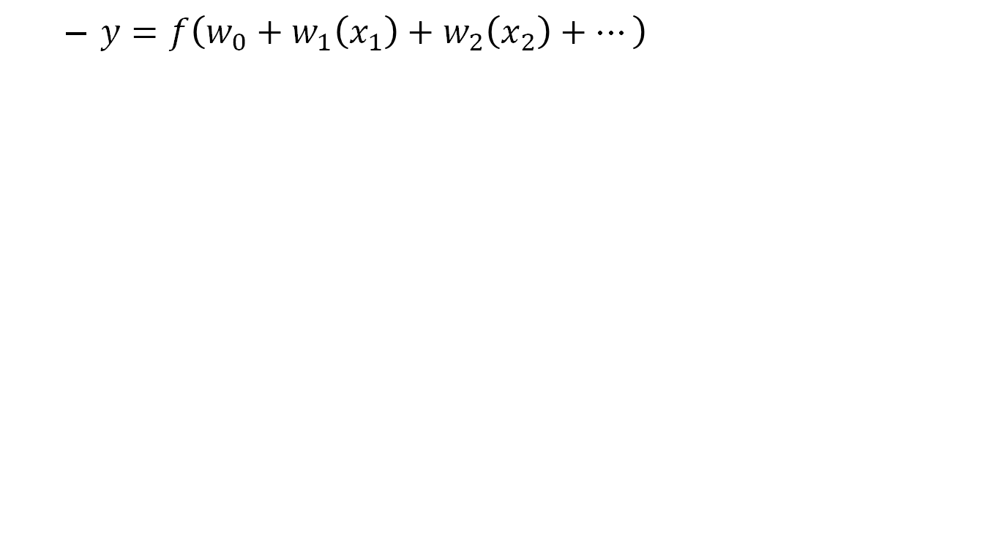
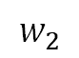
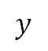
Some definitions
$y=f\left(w_{0}+w_{1}\left(x_{1}\right)+w_{2}\left(x_{2}\right)+…\right)$
$$1$$
$$w_{0}$$
ARTIFICIAL NEURON*
$$w_{1}$$
$$x_{1}$$
$$y$$
f($w_{0}+w_{1}\left(x_{1}\right)+w_{2}\left(x_{2}\right)+…$)
$$w_{2}$$
$$x_{2}$$
* Also called as PERCEPTRON

Slide 63
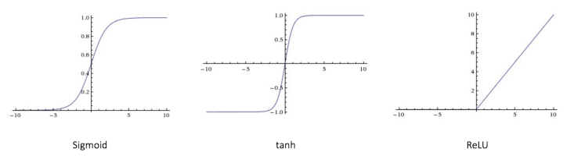
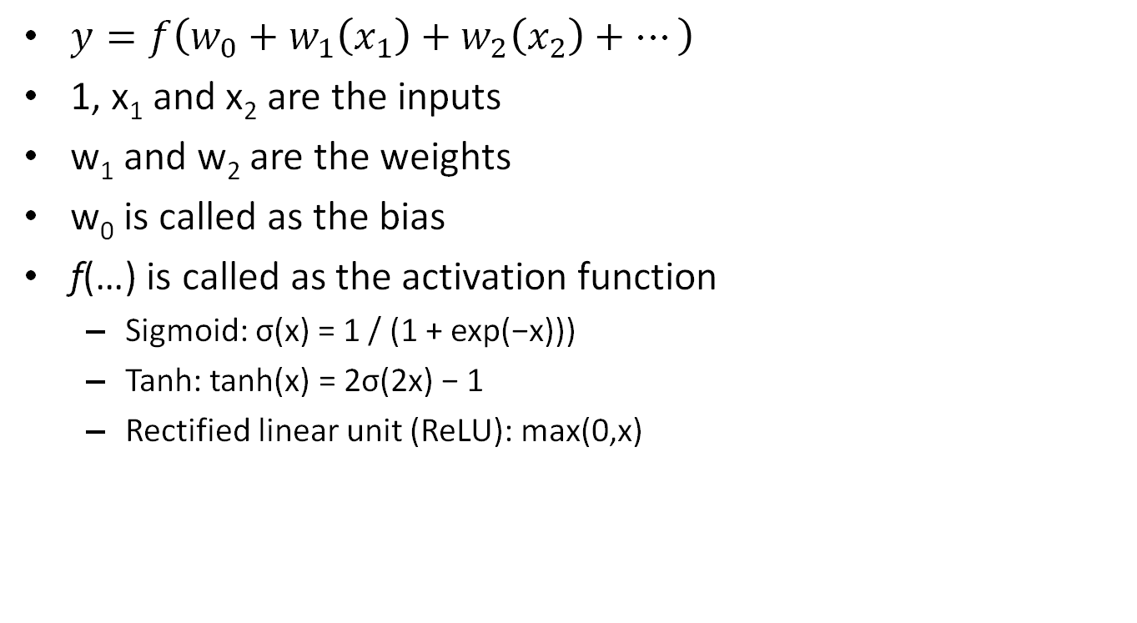
Artificial neuron
$y=f\left(w_{0}+w_{1}\left(x_{1}\right)+w_{2}\left(x_{2}\right)+…\right)$
1, x₁ and x₂ are the inputs
w₁ and w₂ are the weights
w₀ is called as the bias
f(…) is called as the activation function
Sigmoid: σ(x) = 1 / (1 + exp(−x)))
Tanh: tanh(x) = 2σ(2x) − 1
Rectified linear unit (ReLU): max(0,x)

Slide 64
Composite functions
Example 1:
f(x) = -4x + 9; g(x) = 2x – 7
f(g(x)) = -4(2x-7) + 9 = -8x + 37
g(f(x)) = 2(-4x+9) – 7 = -8x + 11

Slide 65
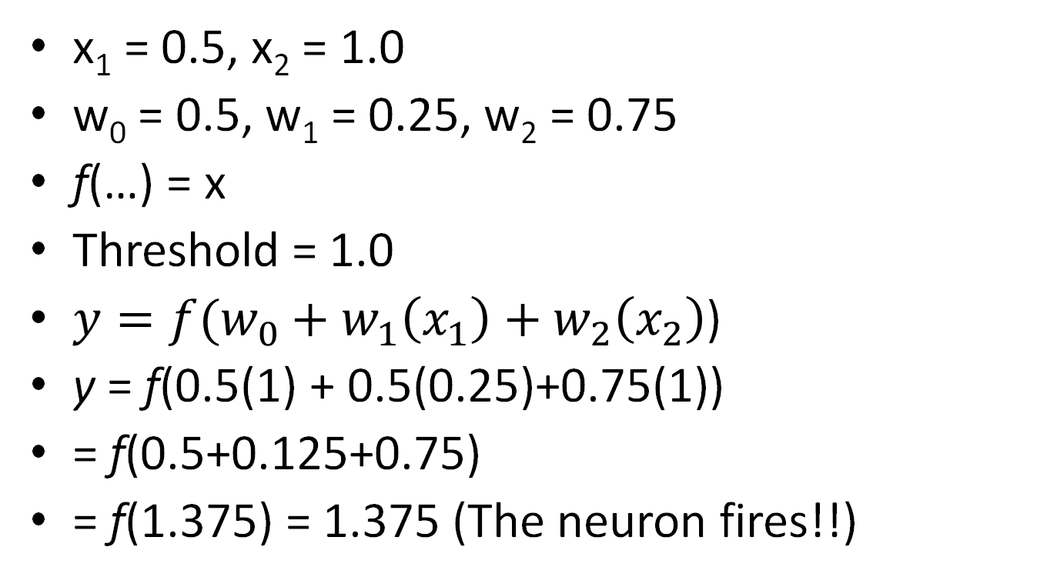
Example
x₁ = 0.5, x₂ = 1.0
w₀ = 0.5, w₁ = 0.25, w₂ = 0.75
f(…) = x
Threshold = 1.0
$y={f(w}_{0}+w_{1}\left(x_{1}\right)+w_{2}\left(x_{2}\right)$)
y = f(0.5(1) + 0.5(0.25)+0.75(1))
= f(0.5+0.125+0.75)
= f(1.375) = 1.375 (The neuron fires!!)

Slide 66
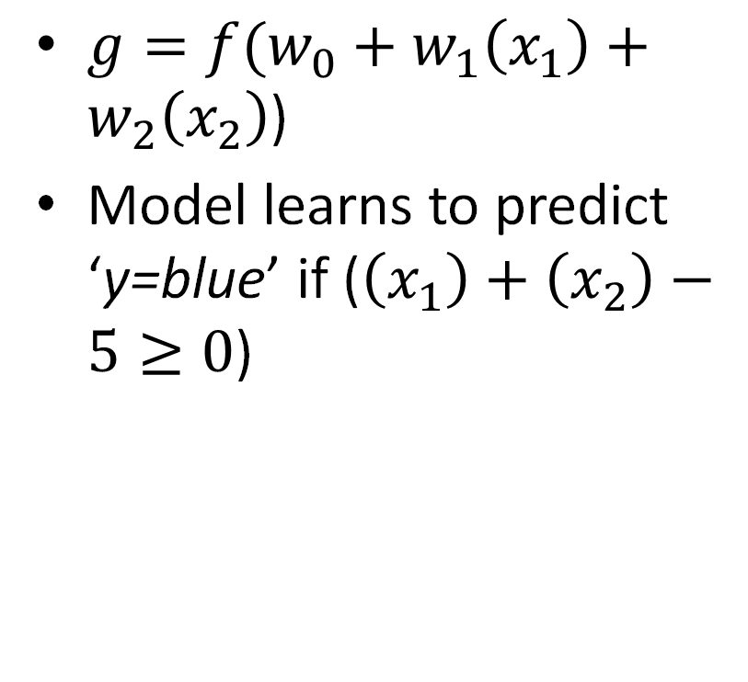
Decision boundary
$g={f(w}_{0}+w_{1}\left(x_{1}\right)+w_{2}\left(x_{2}\right)$)
Model learns to predict ‘y=blue’ if ($\left(x_{1}\right)+\left(x_{2}\right)−5≥0$)
x₂
5
4
3
2
1
1
2
3
4
5
x₁

Slide 67
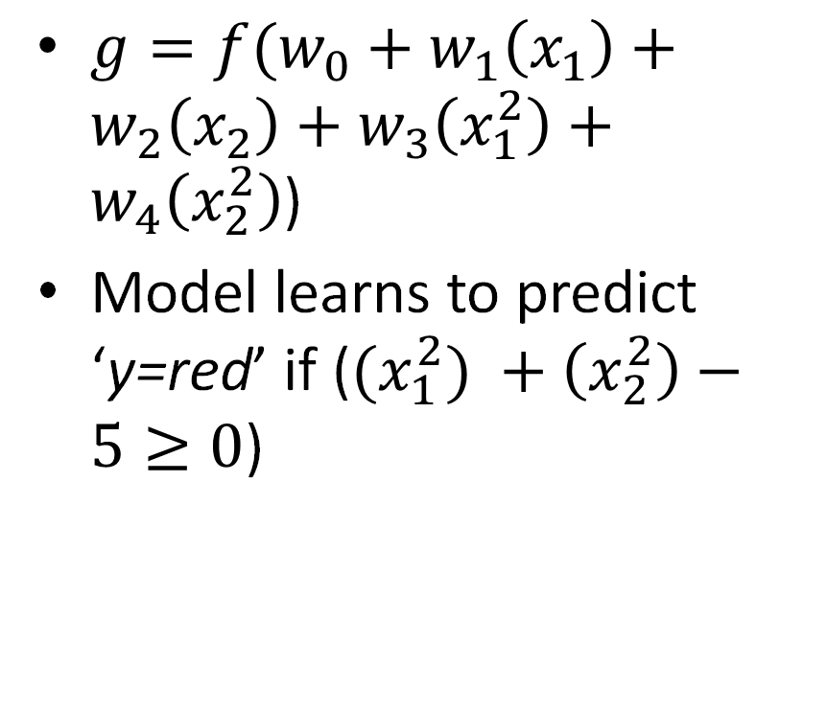
Decision boundary
x₂
$g={f(w}_{0}+w_{1}\left(x_{1}\right)+w_{2}\left(x_{2}\right)+w_{3}\left(x_{1}^{2}\right)+w_{4}\left(x_{2}^{2}\right)$)
Model learns to predict ‘y=red’ if (${(x}_{1}^{2}) +\left(x_{2}^{2}\right)−5≥0$)
5
-5
5
x₁
-5

Slide 68
Linear models and decision boundaries
Non-linear decision boundaries need to be modeled carefully
Linear models may not be able to efficiently handle nonlinear decision boundaries
How about we transform them?
Neural networks are meant for this task!
Neural network: Layers of artificial neurons (i.e., logit units or functions)

Slide 69
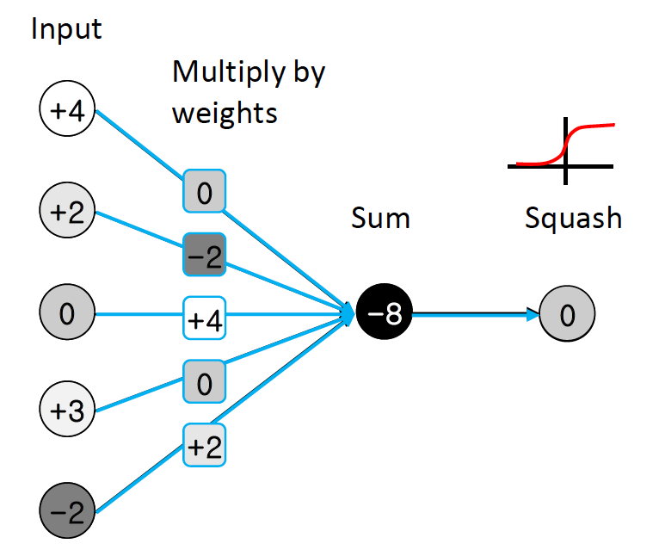
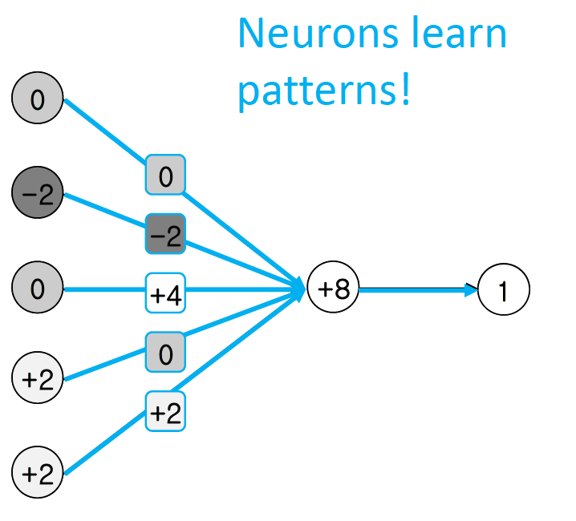
Neural network computations

Slide 70
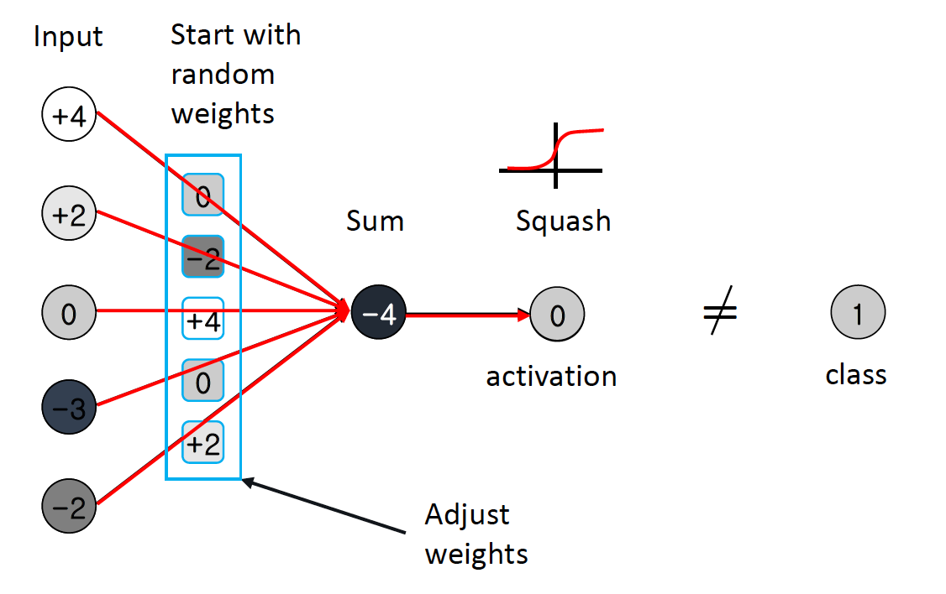
Neural network computations

Slide 71
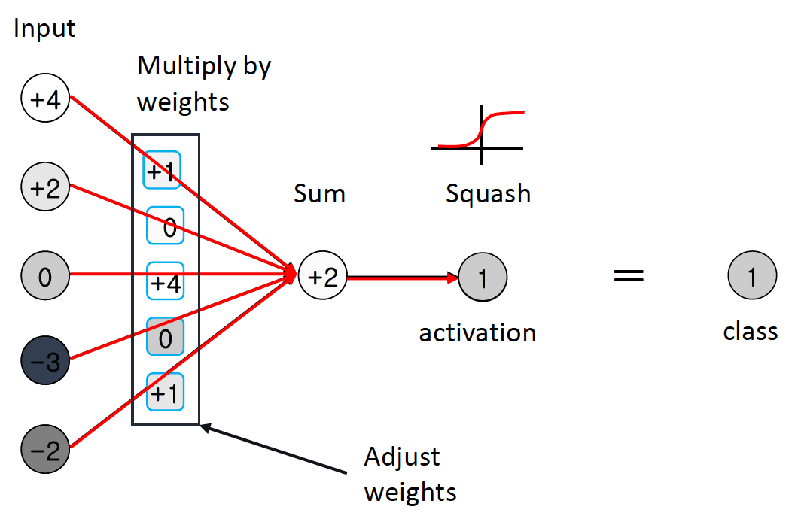
Neural network computations

Slide 72
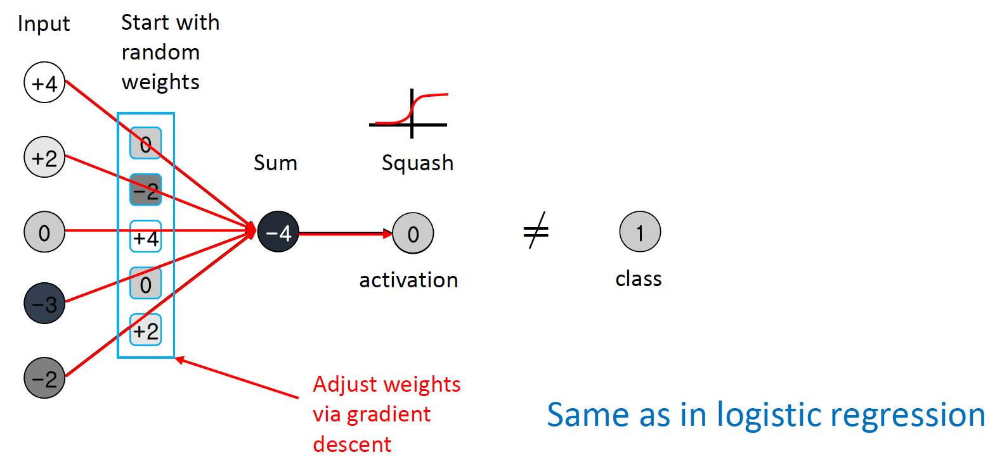
Neural network computations

Slide 73
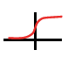
Neural network computations
Input signal
3
0
3
Sigmoid activation
0
0
+1
4
1
Weighted sum
-4
-1
-2
0

Slide 74
Neural network computations
Input signal
0
0
-4
Sigmoid activation
0
3
+1
0
0
Weighted sum
3
-1
-2
0

Slide 75
Neural network computations
Input signal
0
-1
-4
1
-4
0
-1
3
1
7
1
-1
3
1
0
0
-1
-2
1
-5
0

Slide 76
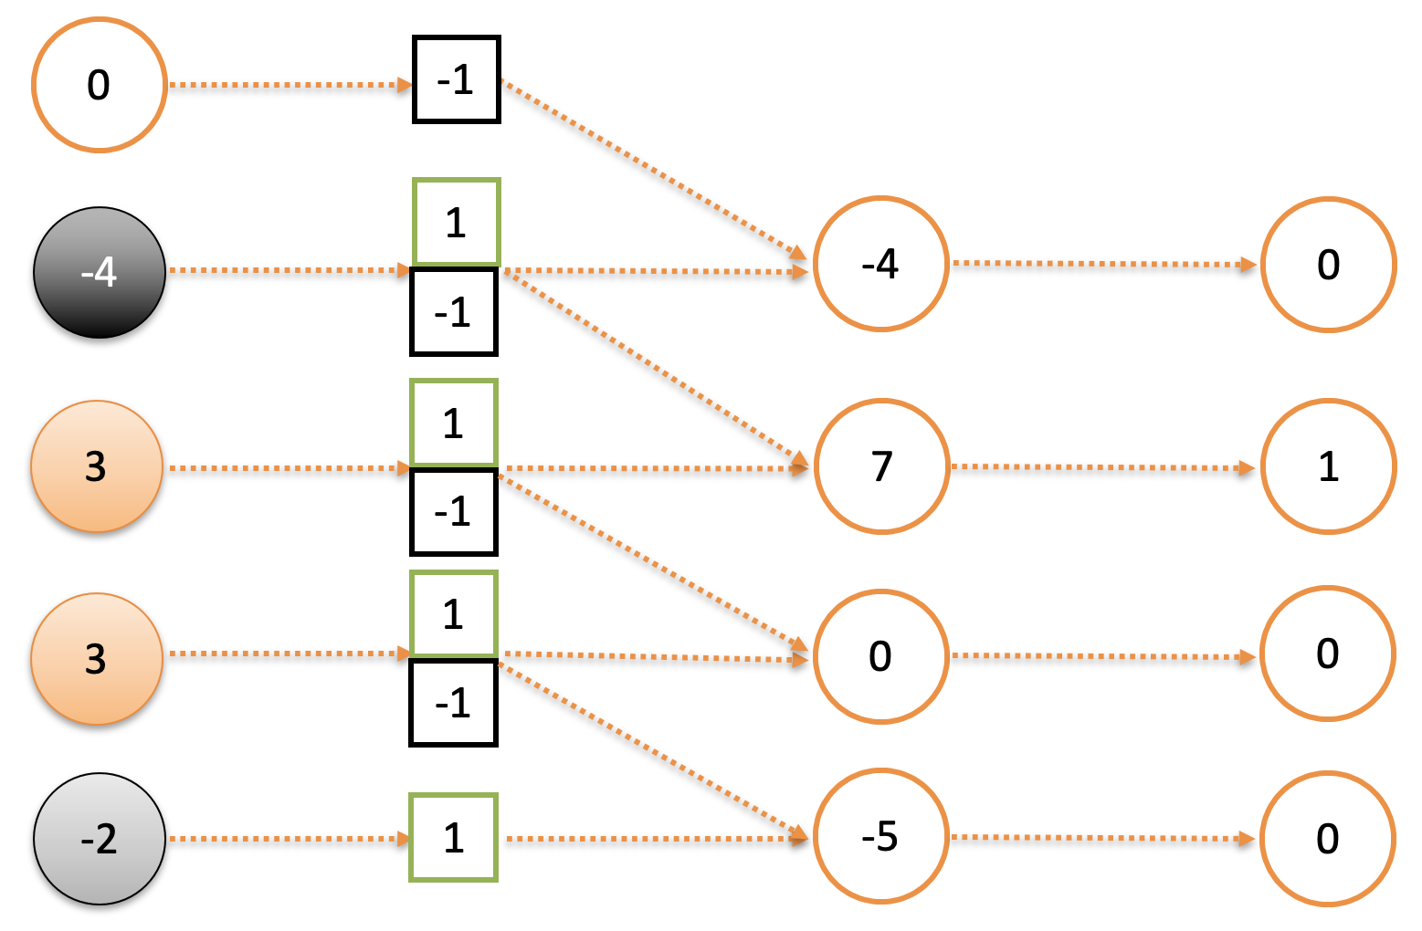
Neural network computations
New weights are of size 2x1 (‘filter’ or ‘kernel’)
New neurons share the same weights
Computationally efficient – you learn the weights only once!

Slide 77


Convolutional operator

Slide 78
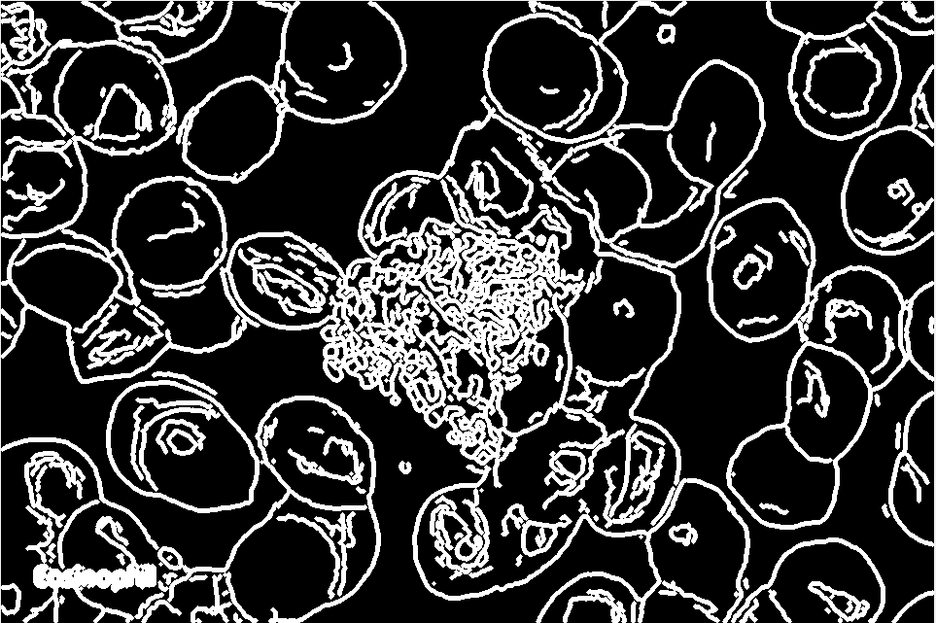
Using neural networks

Slide 79
Using neural networks
…

Slide 80
Using neural networks
Not invariant to translation!
…

Slide 81
Convolution
Detect the same feature at different positions in the input, e.g., image or an ECG signal
Preserve input topology

Slide 82

Modeling strategy (Convolutional neural network)

Slide 83

Neural Networks in R

